Slide 1
Project-led education at the University of Twente
Lisa Gommer
Educational Advisor Engineering Technology
Lisa Gommer, MSc
e.m.gommer@utwente.nl
31st of May, 2016

Slide 2
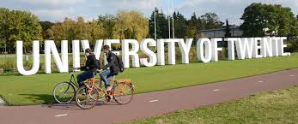
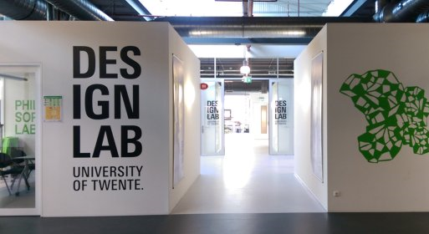
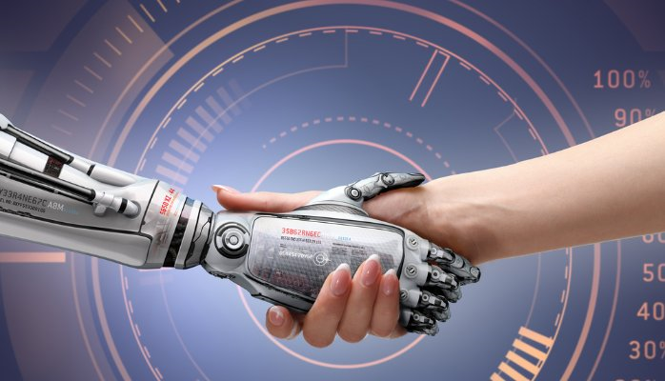
UniversiTY OF TWENTE
High TECH HUMAN TOUCh
http://www.4tu.nl/cee
Notes:
Research intensive university. 9500 students / 3000 staff.
High Tech Human Touch (mix of technical progammes and behavioral and management sciences)

Slide 3
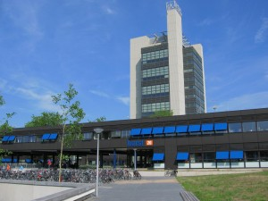
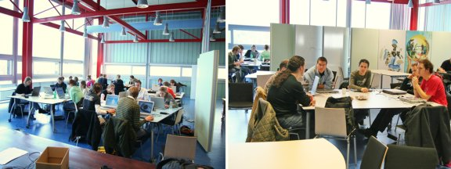
University of Twente
High TeCH Human Touch
Behavioral Management and Social Sciences
Electrical Engineering, Mathematics and Computer Science
Science and Technology
Geo-Information Science and Earth Observation
Engineering Technology
Notes:
Opzet van de presentatie. Iets over de UT (kleine universiteit in Oosten van het land). Zes faculteiten, waarvan Engineering Technology er een is. Projectonderwijs in navolging van Aalborg sinds 1994 (some differences). Bij Industrial Design Engineering sinds de oprichting in 2001. Reden voor keuze destijds: increase motivation and study pace. Also: educating an new type of engineers that not only posess knowledge and skills but are able to integratie these and apply them to solving complex problems.

Slide 4
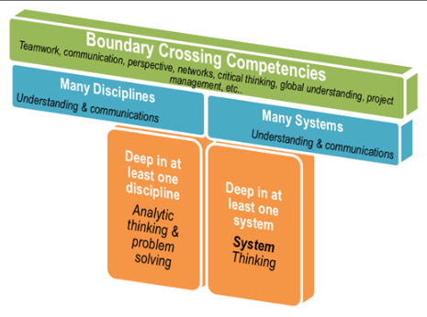
Why an educational innovation?
Twente Educational Model
Educate the student/engineer of the future
self-responsible and active learners
authentic learning experiences
variety in learning methods and other options
T-shaped professional
Increasing student enrollment
Decrease drop-out rates & increase study speed

Slide 5
TEM prinCIPLES
DIDACTICAL anD organisational foundation of TEM
a steady workload is better than ‘binge learning’ for tests,
frequent feedback helps students adjust their learning,
variety in teaching methods keeps students engaged,
community helps students help each other,
ambitions must be clear and high, yet realistic, and
teachers work best in teams, with minimal regulation.

Slide 6
New students
Responsible learners

Slide 7
Notes:
Overzicht van alle opleidingen (bachelor)
Bestaan uit 12 modules met minor ruimte
Soms afstuderen in één geheel soms 2 losse modules
Veel samen tussen opleidingen (gedeelde modules, multidisciplinair). Bijv.

Slide 8
EEMCS
BMS
ET
ST
Notes:
Faculteiten
Science & Techno
Engineering Techno
Behavioral man & soc sci
Electr eng math & comp sci

Slide 9
Thematic Project Education in modules
General design
Variation in:
Part 1
Project
Group size
Part 2
Design / structure
Part 3
Loosely related subject (for instance Mathematics)
Assessment method

Slide 10
Project within our modules
Example of et
Second year module, consumer products
Multidisciplinary project
Industrial Design
Mechanical Engineering
Industrial Engineering and Management
Source: https://www.utwente.nl/tom/en/mytom/jan2015ew-en/

Slide 11
Project within our modules
Example of et
Setting:
Groups of 6-8 students
Each group has students of all three programmes
Each group has a tutor
There is a real company as a ‘client’
Groups act as competing design companies

Slide 12
Project within our modules
Example of ET
Notes:
Product presentation market (part of the assessment).
Coffee maker.

Slide 13
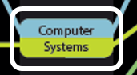
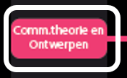
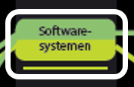
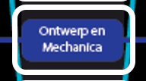
TEM in our modules
Practical examples of TEM
Module 5, Electrical Engineering
Assessment
Module 1, Communication Sciences
Formation groups
Module 2, Computer Sciences
Formative assessment
Module 4, Mechanical Engineering
Flipped classroom
Module 1, Industrial Design
Team Based Learning
Resources:
https://www.utwente.nl/tom/mijntom/
https://www.3tu.nl/cee/en/research-innovation/
https://www.utwente.nl/telt/experiences/
https://www.utwente.nl/tom/intra/documenten/
Notes:
- M 5 EE: keuze voor toetsing + herkansing alleen als deelname aan review sessie (studenten die het gehaald hebben kunnen gaan voor bonuspunten)
- M1 CW: Speeddaten om groepjes te vormen. Een aantal randvoorwaarden meegeven, plus dingen die waar ze van tevoren over na moesten denken (Bijvoorbeeld hun rol in de groep, hoe konden zij bijdragen)→ passen in M1 omdat stud elkaar dan nog niet kennen
M2 TI: formatieve toetsing dmv. Pubquizes, last man standing, etc. studenten zijn super gemotiveerd en studeren om te kunnen winnen
M4 WB: flipped classroom, experiment afgelopen jaar.
M1 Industrial Design, TBL exam
Andere voorbeelden van vernieuwingen
M3 EE: Perusall, straks meer
M3 BIT-TBK: peer feedback: studenten moesten elkaar feedback geven op het groupsproces (digitaal, elkaar beoordelen mbv een likert schaal). Binnen BMS wordt dit breed toegepast om feedback te geven, bij het ITC laten ze de feedback van de studeten ook meewegen in het eindcijfer
HTHT modules: zijn multidisciplinair, maar verderdere vernieuwing hangt echt van de docenten af…
Over modules heen worden er al veel microlectures opgenomen en toegepast in het onderwijs.

Slide 14
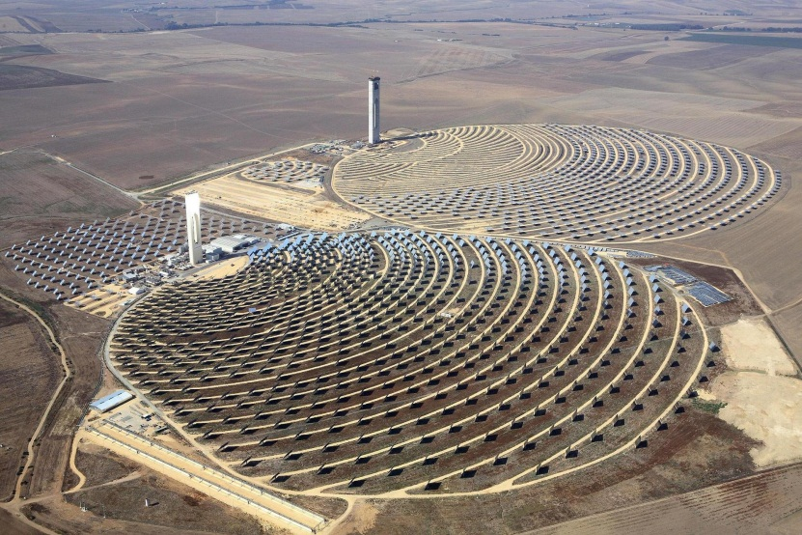
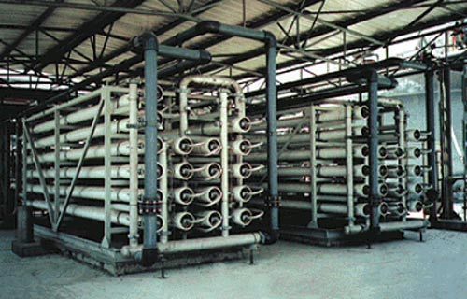
ME MODULE 3: ENERGY AND SUSTAINABILITY
Assignment for a team of experts on Thermodynamics and LCA
Design an installation based on Concentrated Solar Power, that can supply Aruba with electricity all year long. Besides this, deliver the required electricity and/or heat for drinking-water production on Aruba. In the design of the installation, take into account the impact on environment and society.
Concentrated Solar Power
Water production

Slide 15
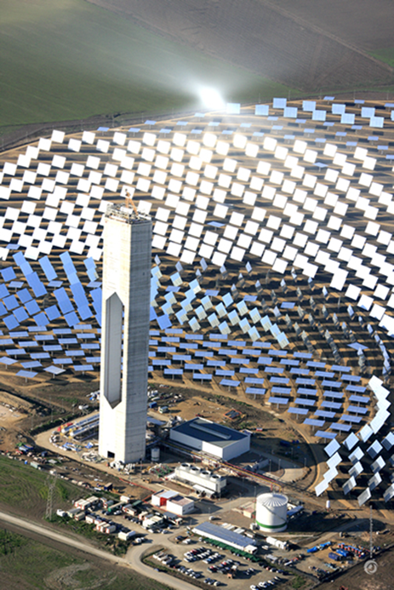
ME MODULE 3: ENERGY AND SUSTAINABILITY
High Tech Project with realistic Problem
First year WB, third module (April - June)
Disciplines in this module:
Technical Thermo Dynamics
Chain Management / Life Cycle Analysis
Materials Science

Slide 16
ME MODULE 3: ENERGY AND SUSTAINABILITY
Skills to be applied during the project:
Dealing with uncertainties / estimation
Modelling and programming
Combination of disciplines (synergy)
Writing a (technical) report
Presentation to a technical audience

Slide 17
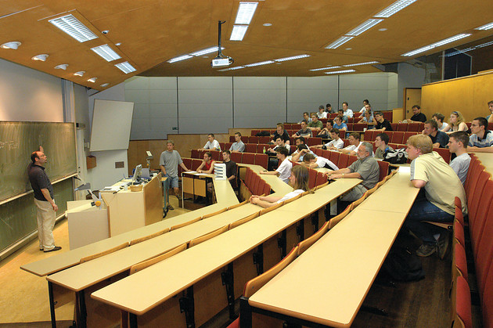
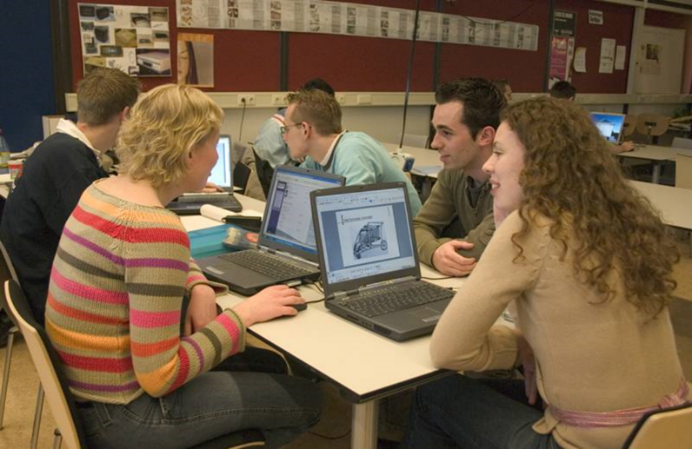
Role of the teacher
Changing the way of teaching

Slide 18
ANY questions?

